Slide 1
Introduction to the 4th Webinar: ERC Grants and the new Horizon 2020 work programme 2019 Alexandre Voillequin, CNRS

Slide 2
RI-LINKS2U is funded by the Horizon 2020 Framework Programme for Research and Innovation under grant agreement no. 692476.
RI-LINKS2UA – Strengthening Research & Innovation Links towards Ukraine
Project Coordinator – Centre for Social Innovation (ZSI), Vienna, Austria
Duration – 36 Months, February 2016 - January 2019
Project Budget – around € 1 million, funded by EC under Horizon 2020
RI-LINKS2UA aims to facilitate the policy dialogue on R&I between EU and Ukraine by ad-hoc operational tailor-made support reflecting the actual demands from the EU-Ukraine R&I affairs through analytical evidence and policy advice.

Slide 3
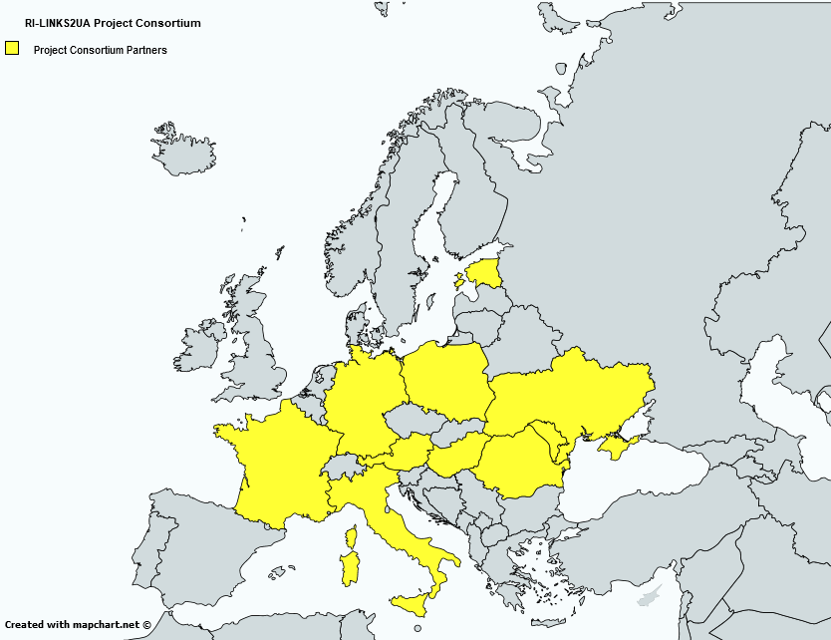
The Project Consortium
8 partners from EU Member States (MS) and 4 partners from Horizon 2020 Associated Countries (AC) (1 from Moldova and 3 from Ukraine).
ETAq
PLUS: support from 7 ministries in EU MS and business networks
IPPT-PAN
DLR
MESU, NASU, NIP
CIP
CNRS
ZSI
RCISD
UEFISCDI
META

Slide 4
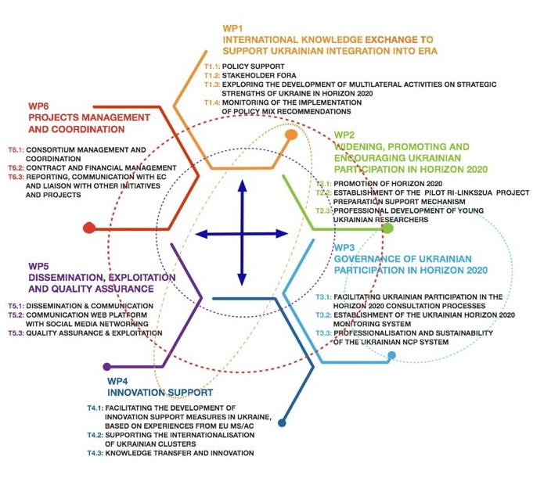
WP & Objectives of RI-LINKS2UA

Slide 5
R&I-LINKS2UA Webinars
To provide Ukrainian R&I actors with information about Horizon 2020 calls and rules for participation
Each webinar will focus on a specific aspect of H2020
Next webinars : Marie Skłodowska-Curie Actions and Research Infrastructures

Slide 6
R&I-LINKS2UA Fourth Webinar
General Introduction to the impact section of a H2020 proposal:
Agenda:
Introduction to the webinar, Alexandre Voillequin – CNRS (10’)
ERC Grants and the new Horizon 2020 work programme 2019, Valentyna Andrushchenko, Ukrainian ERC NCP, Alexandre Voillequin, French ERC NCP, CNRS (30’)
Questions & Answers (20’)

Slide 7
Thank you for your attention!
Alexandre Voillequin
CNRS
alexandre.voillequin@cnrs-dir.fr

