Slide 1
Olga Zyrina, IPPT-PAN, Poland

Slide 2
National Contact Point
for Research Programmes of the EU
Institute of Fundamental Technological Research Polish Academy of Sciences
The Polish NCP Organization
Supporting research stakeholders over
the last 16 years
NCP for HORIZON 2020 & Euratom-Fission
Coordinator of NCP & EURAXESS Networks in Poland
Cooperation with the Enterprise Europe Network (EEN) and Thematic Contact Points

Slide 3
Network of NCPs in Poland
NCP-PL + 11 Regional Contact Points
Our mission: to support the participation of Polish research institutions, enterprises and organisations in the Framework Programme H2020.
NCP-PL

Slide 4
HORIZON 2020
Horizon 2020 – is the biggest EU Research and Innovation programme with nearly €80 billion of funding available over 7 years (2014 to 2020)

Slide 5
HORIZON 2020
The Research and Innovation funded within the HORIZON 2020 are grouped under 3 broad headings:
Excellent science (funding promising research and technologies)
Industrial leadership (incl. nanotechnologies, advanced materials, biotechnology and space)
Societal challenges (incl. health, efficient energy, climate action, environment and secure societies)

Slide 6
HORIZON 2020
Other programmes funded under the HORIZON 2020 include:
Spreading Excellence and Widening Participation
Science with and for Society
Cross-cutting activities (industry in the circular economy, sustainable cities)
Fast Track to Innovation Pilot
European Institute of Innovation and Technology (EIT)
Smart Cyber-Physical Systems
Euratom

Slide 7
HORIZON 2020
Information about calls could be found at:

Slide 8
HORIZON 2020 and Ukraine
Legal entities eligible to receive the funding through Horizon 2020 can be located in:
The Member States of the European Union (EU13 and EU15 – new and old member states)
The Countries Associated to Horizon 2020 (such as Iceland, Norway, Serbia, Israel, Moldova, Ukraine, Georgia and 8 others)

Slide 9
HORIZON 2020 and Ukraine
Thanks to the Agreement for the Association of Ukraine to Horizon 2020 (signed on March 20, 2015), researchers, businesses and innovators from Ukraine are now able to fully participate in Horizon 2020 on equal terms with EU Member States and other associated countries.

Slide 10
The 'RI-LINKS2UA' project was launched with a kick-off meeting in Vienna in February 2016.
RI-LINKS2UA is a 3-year project funded under the Horizon 2020 (February 2016 – January 2019).

Slide 11
The overall aim of the 'RI-LINKS2UA' project is to further support and enhance the integration of Ukraine to the European Research Area and
to increase the participation of Ukrainian stakeholders (universities, research institutions, business actors, SMEs, etc.) in successful Horizon 2020 projects.

Slide 12
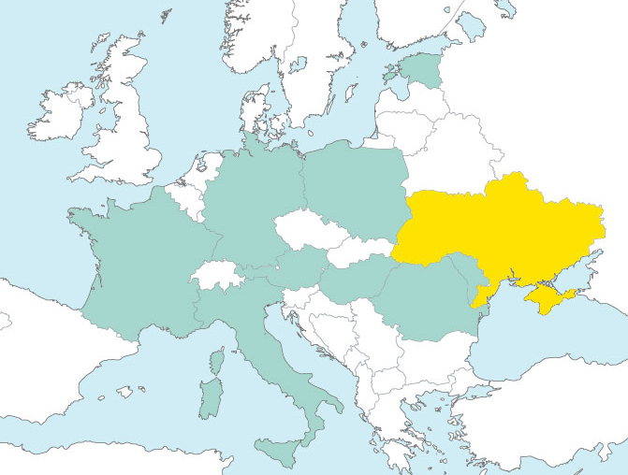
'RI-LINKS2UA' project participants
(from 10 countries)
Centre for Social Innovations - ZSI, Austria - Coordinator
MESU, Ukraine
CNRS, France
DLR, Germany
NASU, Ukraine
IPPT-PAN, Poland
ETAg, Estonia
RCISD, Hungary
UKRTECHINFORM, Ukraine
UEFISCDI, Romania
META, Italy
CPI, Moldova
EST
GER
POL
Ukraine
FRA
AUS
MOL
HUN
ROM
ITA

Slide 13
'RI-LINKS2UA' work packages (6)
International Knowledge exchange to support the integration of Ukraine into ERA
Widening, promoting and encouraging Ukrainian participation in Horizon 2020
Governance of Ukrainian participation in Horizon 2020
Innovation Support
Dissemination, Exploitation and Quality assurance
Projects Management and Coordination

Slide 14
'RI-LINKS2UA' stakeholders
Policy Makers (incl. funding agencies and EC)
Researchers (research institutions, Higher Education Institutions)
SMEs, industry clusters, social entrepreneurs
Civil Society Organisations
Interested wider public

Slide 15
'RI-LINKS2UA' main activities
Policy Dialogue Support
Governance of Ukrainian participation in Horizon 2020
Widening & Promoting Ukrainian participation in H2020
Innovation Support
Dissemination &
Exploitation

Slide 16
Policy Dialogue Support
Preparation of policy briefs and analytical reports supporting the EU-Ukraine STI policy dialogue
Develoment of a roadmap with an action plan incl. monitoring report of the implementation of RTI policy
Organising 2 stakeholder forums (at least 70 stakeholders/forum from policy-making, industry, academia, civil society)

Slide 17
Widening & Promoting Ukrainian participation in H2020
5 Info days on Horizon 2020 in Ukraine
10 webinars targeting Horizon 2020 calls and project preparation
Establishment of the pilot RI-LINKS2UA project preparation support mechanism (20 project proposals will be suported with a small project preparation grant including travel costs)
Organising summer school for 30 young Ukrainian researchers

Slide 18
Governance of Ukrainian participation in Horizon 2020
Establishment of national monitoring system of the Ukrainian participation in Horizon 2020
Establishment of „national knowledge groups” between Ukrainian NCPs, Ukrainian Programme Committee Members (PCMs) and researchers
Knowledge exchange through twinning meetings between EU and Ukrainian PCMs
Targeted training for Ukrainian NCPs

Slide 19
Innovation Support
Promotion of at least 10 research-based industrial clusters in Ukraine
Targeted training for cluster managers
Establishment of direct contacts between cluster managers from Ukraine and EU
Organisation of study visits of Ukrainian representatives to relevant clusters in the EU
Targeted training for researchers and innovators on suporting innovation, exploitation and financing innovation

Slide 20
Dissemination and Exploitation
We invite you to follow the ‘R&I LINKS2UA’ project activities by
Visiting Info Days
Joining Webinars
Contacting the Ukrainian National Contact Points (NCPs)

Slide 21
Thank you for your attention! Дякую за увагу!
Olga Zyrina
IPPT-PAN, Warsaw, Poland

