Slide 1
Euratom Research and Training Programme
Work Programme 2016-2017
Mykola DŽUBINSKÝ
DG RTD/Directorate Energy/Unit G.4

Slide 2
Outline of the presentation
Euratom Treaty and policy frameworks
Euratom Research and Training programme
European nuclear fission landscape
EU-Ukraine collaboration in nuclear domain
Work Programme 2016-2017 and fission call
Information is not legally binding

Slide 3
Outline of the presentation
Euratom Treaty and policy frameworks
Euratom Research and Training programme
European nuclear fission landscape
EU-Ukraine collaboration in nuclear domain
Work Programme 2016-2017 and fission call
Information is not legally binding

Slide 4
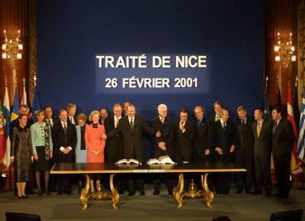
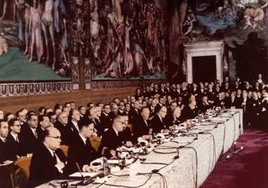
Euratom Treaty
Paris 1951
The Treaty establishing the European Coal and Steel Community (ECSC)
1997
Treaty of Amsterdam
Maastricht 1992
Treaty on European Union
15 Member States
Rome 1957
12 Member States
Treaty establishing the European Economic Community (EEC)
Treaty establishing the European Atomic Energy Community (Euratom)
2001
Treaty of Nice
6 Member States
2009
Lisbon Treaty
Euratom Treaty
27 Member States
(now 28)
Information is not legally binding

Slide 5
Euratom Treaty
Main fields of action
Rome 1957: Signature of the Treaty establishing the European Atomic Energy Community (Euratom)
Nuclear Energy Development, including Research Activities (art.4-11)
Health and Safety (art.30-39)
Safeguards (Guarantees for Peaceful Uses) (art.77-85)
External Relations (art.101-106)
Information is not legally binding

Slide 6
Policy Context [1/2]
Commission's Communication on the “Energy Union Package: A Framework Strategy for a Resilient Energy Union with a Forward-Looking Climate Change Policy” (Feb.2015)
The strategy of the European Energy Union has five mutually-reinforcing and closely interrelated dimensions designed to bring greater energy security, sustainability and competitiveness:
Energy security, solidarity and trust;
A fully integrated European energy market;
Energy efficiency contributing to moderation of demand;
Decarbonising the economy; and
Research, Innovation and Competitiveness
  A new strategy for R&I ... putting the EU at the forefront of smart grid and smart home technology, clean transport, as well as clean fossil fuel and the world's safest nuclear generation, is central to the aim of turning the EU into a motor for growth, jobs and competitiveness
Information is not legally binding

Slide 7
Policy Context [2/2]
Council Directive 2009/71/Euratom of 25 June 2009, and its (post-Fukushima) amendment 2014/87/Euratom, establishing a Community framework for the nuclear safety of nuclear installations
  Introduction of a high-level "Nuclear safety objective for nuclear installations" (Article 8a – (1) new nuclear installations and (2) existing nuclear installations)
Council Directive 2011/70/Euratom of 19 July 2011 establishing a Community framework for the responsible and safe management of spent fuel and radioactive waste
Council Directive 2013/59/Euratom laying down basic safety standards for protection against the dangers arising from exposure to ionising radiation
Information is not legally binding

Slide 8
EU research -
the story so far
1957: Euratom Treaty
  Concept of Community Research programmes
  Joint Research Centre established
1984: 1st Framework Programme (1984-1987)
1987: ‘Single European Act’
  Science becomes a Community responsibility
  2nd Framework Programme (1987-1991)
1990: 3rd Framework Programme (1990-1994)
1992: Treaty on European Union
  Role of RTD in the enlarged EU
1994: 4th Framework Programme (1994-1998)
1998: 5th Framework Programme (1998-2002)
2000: European Research Area (ERA) launched
2002: 6th Framework Programme (2002-2006)
2006: 7th Framework Programme (2007-2013)
  EC Framework Programme (2007-2013)
  Euratom Framework Programme 'FP7' (2007-2011)
2011: Euratom Framework Programme 'FP7+2' (2012-2013)
2013: Horizon 2020 (2014-2020) & Euratom programme (2014-2018)
Information is not legally binding

Slide 9
Outline of the presentation
Euratom Treaty and policy frameworks
Euratom Research and Training programme
European nuclear fission landscape
EU-Ukraine collaboration in nuclear domain
Work Programme 2014-2015 and fission call
Information is not legally binding

Slide 10
Euratom Programme
2014-2018
Research and Training Programme of Euratom (2014-2018) complementing the Horizon 2020 Framework Programme for Research and Innovation
[Council Regulation on 16 December 2013 - O.J.EU L347 20 Dec.2013]
General objective: To pursue nuclear research and training activities with an emphasis on continuous improvement of nuclear safety, security and radiation protection, notably to potentially contribute to the long-term decarbonisation of the energy system in a safe, efficient and secure way
That general objective shall be implemented through:
  Activities in the form of indirect and direct actions
  Cross-cutting activities within the Euratom Programme (i.e. fusion/fission)
  Cross-cutting activities & interfaces with H2020 Framework Programme
  International cooperation with third States and international organisations
Information is not legally binding

Slide 11
→ Council Regulation of 16 December 2013
Euratom Programme
Budget
Euratom Programme (2014-18) complementing H2020
Indirect actions
DG-RTD
Fusion R&D
Programme
€ 728 million
(45 %)
Indirect actions
DG-RTD
Nuclear Fission,
Safety and
Radiation Protection
€ 315 million
(20 %)
Direct actions
JRC
Nuclear Safety
and Security
€ 560 million
(35 %)
Total budget: € 1603 million
(outside H2020) → Council Decision of 13 December 2013
ITER (2014-2020) through JU-F4E: € 2915 million in current values
Information is not legally binding
Notes:
11

Slide 12
Euratom Programme
Indirect actions
Specific objectives (Indirect Actions)
Supporting safety of nuclear systems
Contributing to the development of safe, longer term solutions for the management of ultimate nuclear waste, including final geological disposal as well as partitioning and transmutation
Supporting the development and sustainability of nuclear expertise and excellence in the Union
Supporting radiation protection and development of medical applications of radiation, including, inter alia, the secure and safe supply and use of radioisotopes
Moving towards demonstration of feasibility of fusion as a power source by exploiting existing and future fusion facilities
Laying the foundations for future fusion power plants by developing materials, technologies and conceptual design
Promoting innovation and industry competitiveness
Ensuring availability and use of research infrastructures of pan-European relevance

Slide 13
Euratom Programme
Direct actions
Specific objectives (Direct Actions)
Improving nuclear safety including: nuclear reactor and fuel safety, waste management, including final geological disposal as well as partitioning and transmutation; decommissioning, and emergency preparedness
Improving nuclear security including: nuclear safeguards, non-proliferation, combating illicit trafficking, and nuclear forensics
Increasing excellence in the nuclear science base for standardisation
Fostering knowledge management, education and training
Supporting the policy of the Union on nuclear safety and security

Slide 14
Euratom Programme
Implementation
The indirect actions of the Euratom Programme should mutually reinforce research efforts of the Member States and the private sector
Therefore, the priorities of the work programmes are to be established on the basis of appropriate inputs from national public authorities and nuclear research stakeholders grouped in bodies or frameworks such as technology platforms, European joint programmes and technical forums for nuclear systems and safety, management of ultimate waste and radiation protection/low-dose risk, fusion research, or any relevant organisation or forum of nuclear stakeholders
The priorities for direct actions are to be established through consultation of the policy DGs of the Commission and of the JRC GB
The JRC must notably contribute to the nuclear safety research needed for safe, secure and peaceful use of nuclear energy and other non fission applications. The JRC will provide a scientific basis for the relevant Union policies and, where necessary, react within the limits of its mission and competence to nuclear events, incidents and accidents

Slide 15
Outline of the presentation
Euratom Treaty and policy frameworks
Euratom Research and Training programme
European nuclear fission landscape
EU-Ukraine collaboration in nuclear domain
Work Programme 2014-2015 and fission call
Information is not legally binding

Slide 16

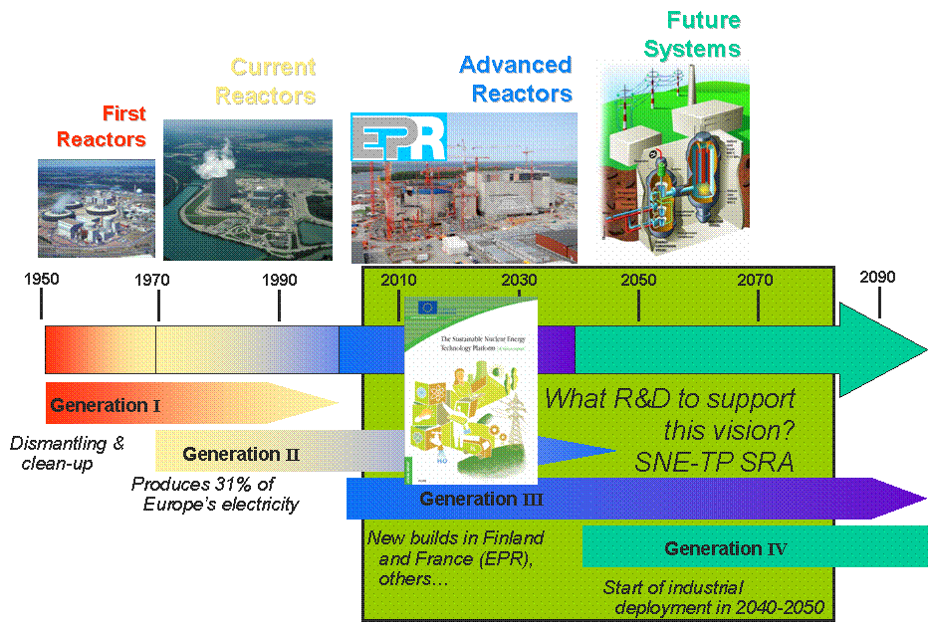
Sustainable Nuclear Energy
Technology Platform (SNETP)
Information is not legally binding

Slide 17
SNETP
Three pillars
Information is not legally binding
Nuclear Cogeneration Industrial Initiative (NC2I)
'TWG Gen II & III' to implement SRIA
on current and future LWRs
NULIFE NoE
to implement SRIA
on LTO/PLIM
SARNET NoE
to implement SRIA
on Severe Accidents
SUSTAINABLE NUCLEAR ENERGY TECHNOLOGY PLATFORM (SNETP)
NUGENIA
More than 100 members;
a shared vision of the future of nuclear energy in Europe
  SRA issued in 2009 and updated in 2013
  Deployment Strategy issued in 2010
European Sustainable
Nuclear Industrial Initiative (ESNII)
Notes:
17
17

Slide 18






NUGENIA
Eight technical areas
1 Plant safety and risk assessment
2 Severe accidents
3 Core and Reactor operation
4 Integrity assessment of systems, structures and components
5 Fuel, waste management (all but geological disposal) and dismantling
6 Innovative Gen III design
7 Harmonisation
8 Inspection
Information is not legally binding

Slide 19
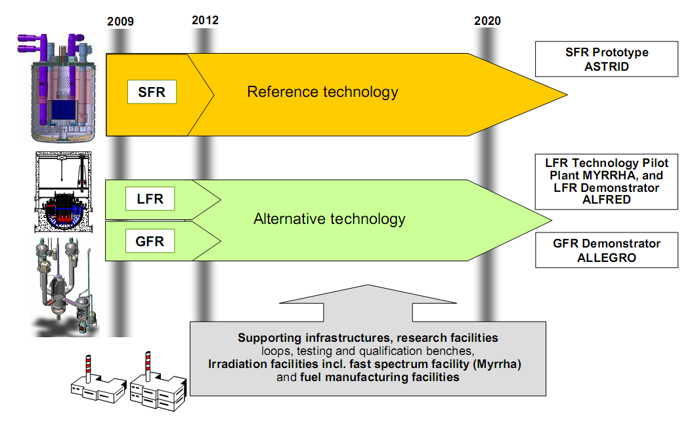
European Sustainable Nuclear
Industrial Initiative
French actors get organised (650M€)
Open to EU / international cooperation
Belgian programme
for MYRRHA, 60M€ / 5 years
4 CE countries support to ALLEGRO
Romania could host ALFRED
Demonstrators are a required step for assessing the technology in order to bring it to the market.
No prioritization between gas and lead cooled reactors, in complementarity to Sodium technology.
Information is not legally binding

Slide 20











Multidisciplinary European
Low-Dose Initiative (MELODI)
Multidisciplinary approach to resolving outstanding issues relating to risk from low and protracted exposure to ionising radiation: RP, (radio)biology, health physics, genomics, epidemiology, …
Main European RP research funding organisations
‘Joint Programming Initiative’ linking national and Euratom programmes → Strategic R&I Agenda
Project DoReMi (Network of Excellence)
Euratom calls for proposal increasingly oriented towards MELODI requirements
Information is not legally binding

Slide 21
















Implementing Geological Disposal of Radioactive
Waste – Technology Platform
IGD-TP
Implementation-oriented R&D activities on all remaining key aspects of deep geological disposal of spent fuel and long-lived radioactive waste
Demonstration on the technologies and safety
Main European RW-GD research funding organisations
Euratom calls for proposal largely oriented towards IGD-TP requirements
Information is not legally binding

Slide 22
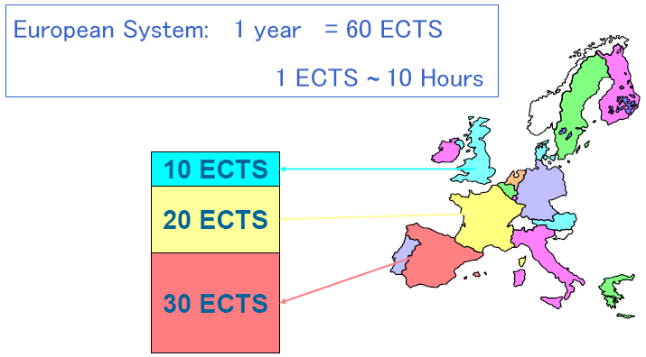

ENEN EDUCATION: “An agenda for new skills and jobs - A EU contribution towards full employment”, COM(2010)682 => lifelong learning and cross-border mobility
European Nuclear
Education Network
Bologna Declaration on the "European Higher Education Area"
(June 1999 – 47 signatory States)
=> “European Credit Transfer and accumulation System” /ECTS/
Copenhagen Declaration on “enhanced European cooperation in VET”
(November 2002 – signed by all 28 EU Member States)
=> “European Credit system for Vocational Education and Training” /ECVET/
BOLOGNA 1999:
mutual recognition of academic grades
COPENHAGEN 2002:
Lifelong learning and cross-border mobility
Information is not legally binding

Slide 23

Strategic Energy Technology Plan (SET-Plan) & nuclear fission
Key EU technology challenges for the next years
… to meet 2020 targets:
  Maintain competitiveness in fission technologies, together with long-term waste management solutions
… to meet 2050 vision:
  Complete the preparations for the demonstration of a new generation (Gen-IV) of fission reactors for increased sustainability
Priority European Industrial Initiatives:
  Sustainable nuclear fission initiative: focus on the development of Generation-IV technologies
Information is not legally binding

Slide 24
Outline of the presentation
Euratom Treaty and policy frameworks
Euratom Research and Training programme
European nuclear fission landscape
EU-Ukraine collaboration in nuclear domain
Work Programme 2014-2015 and fission call
Information is not legally binding

Slide 25
EU-Ukraine
collaboration
Legal basis
for nuclear fission:
Agreement for Cooperation in the field of nuclear safety (2002)
Agreement for Peaceful uses of nuclear energy (2006)
for nuclear fusion:
Agreement for Cooperation in the field of controlled nuclear fusion (2002)
Information is not legally binding

Slide 26
EU-Ukraine
collaboration
Lines of collaboration
DG DEVCO (EuropeAid)/ European External Action Service / DG JRC
  Nuclear Safety Programme for Ukraine, Joint Support Office
    Concrete dedicated projects in frame of TACIS and Instrument for Nuclear Safety Co-operation (INSC)
    Dedicated budget for 2007-2013 - €524 mln (in total for all countries!)
    340 (!) projects for Ukraine (1991-2010) Examples of projects:
      Training Centre for NNEGC Energoatom Staff
      Upgrade of Reactor Protection System at KhNPP
      http://nuclear.jrc.ec.europa.eu/tacis-insc/
Information is not legally binding

Slide 27
EU-Ukraine
collaboration
Lines of collaboration
DG RTD / DG JRC
  - research and innovation
  in frame of EURATOM research an training programme
Contact Expert Groups for STCU:
  - e.g. CEG – Fusion, CEG – Severe Accident Management
  - research projects
Information is not legally binding

Slide 28
EU-Ukraine
collaboration
Fusion
Coordinating Committee established in 2008
Initially co-chaired from Ukrainian side by Tereshin V.I., currently by Zagorodny A.G
About 40 collaborative activities since then
2nd meeting of the Coordinating Committee
Brussels, November 2013
Mapping of EU-Ukraine activities (25 active)
Ukraine – member of Eurofusion consortium?
Information is not legally binding

Slide 29
EU-Ukraine
collaboration
Fission
High-level technical bilateral meetings in 2010 and 2012
Coordination Committee set up in November 2014
Ukrainian entities participated in 11 Euratom fission FP7&FP7+2 projects, with total budget of participation of ~1,5 mln € and EC contribution of ~1 mln €
Ukrainian entity is a partner in H2020 ESSANUF project, with budget & EC contribution ~130 k€
CC-2 on 18/5/2016 – "mapping" of priorities
Information is not legally binding

Slide 30
Outline of the presentation
Euratom Treaty and policy frameworks
Euratom Research and Training programme
European nuclear fission landscape
EU-Ukraine collaboration in nuclear domain
Work Programme 2014-2015 and fission call
Information is not legally binding

Slide 31
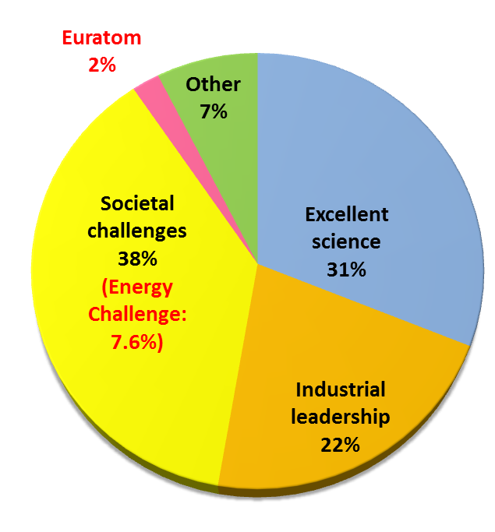
Horizon 2020
Overall budgets
Total budget H2020:
EUR 74,83 billion
Budget of the
Energy Challenge:
EUR 5,69 billion
Information is not legally binding

Slide 32
2016-2017 calls of
the Energy Challenge
Energy Efficiency (EE)
Heating and Cooling
Engaging consumers
Buildings
Industry, services and Products
Innovative financing
Competitive low-carbon energy Technologies (LCE)
Energy system (grids, storage)
Renewable energies
Decarbonising fossil fuels
Socio-economic research
European Research Area in energy
Smart Cities and Communities (SCC)
Light-house demo projects
Nuclear fission and radiation protection
(NFRP)
Nuclear Safety
Radioactive Waste Management
Radiation Protection
Research Reactors
Education and Training
SME instrument (SIE)
Information is not legally binding

Slide 33
The 2016-2017 calls of the Energy Challenge
Call budgets (in Mio €)
Call | 2016 | 2017
EE | 93 | 101
LCE | 352,66 | 367,62
SCC | 60 | 71,50
SME | 46 | 50
NFRP | 57,74 | 47,30
Information is not legally binding

Slide 34
NFRP-2016-2017 call
main features
One EURATOM Work Programme for 2016-2017
One EURATOM fission call for 2016-2017
Single stage evaluation procedure: remote individual phase and consensus plus panel stage in Brussels
Combined indicative budget for Euratom Fission NFRP-2016-2017 call - ~105 MЄ
Information is not legally binding

Slide 35
NFRP-2016-2017 call
main features
Instruments
Research and innovation actions
Basic and applied research, technology development, testing and validation, but limited demonstration or pilot activities
Funding rate: maximum 100%
Coordination and support actions
Networking, coordination or support services, policy dialogues, dissemination, awareness-raising, communication, studies, etc.
Funding rate: maximum 100%
Information is not legally binding

Slide 36
Euratom Fusion
in H2020
European Joint Programming - Co-fund action
Implementation of commonly agreed 2050 Roadmap
Grant to identified beneficiaries
EFDA members form Eurofusion consortium
€ 457.77 million committed in annual instalments over the 5 years, 2014-18 (€ 101.56 million from the 2017 budget)
The Euratom contribution will be limited to a maximum of 55% of the total eligible costs of the action.
Yearly revision of workplan
Information is not legally binding

Slide 37






Fission indirect actions
  Reactor systems
  Safety & competitiveness of nuclear installation
  Advanced nuclear systems for increased sustainability
  Advanced systems for non-electrical uses
  Radiation protection
  Geological disposal
  Research infrastructures
  Training and mobility
  Cross-cutting and International Cooperation (INCO)
Information is not legally binding

Slide 38
Work Programme
2016-2017
Call for Proposals
A - Support Safe Operation of Nuclear Systems
NFRP 1: Continually improving safety and reliability of Generation-II and -III reactors
NFRP 2: Research on safety of fast neutron Generation-IV reactors
NFRP 3: Investigating the safety of closed nuclear fuel cycle options and fuel developments
NFRP 4: Research on the safety of Small Modular Reactors
NFRP 5: Materials research for Generation-IV reactors
Information is not legally binding

Slide 39
Work Programme
2016-2017
Call for Proposals
B - Contribute to the Development of Solutions for the Management of Radioactive Waste
NFRP 6: Addressing key priority R&I issues for the first-of-the-kind geological repositories
NFRP 7: Research and innovation on the overall management of radioactive waste other than geological disposal
NFRP 8: Pan-European knowledge-sharing and development of competence in radioactive waste management
Information is not legally binding

Slide 40
Work Programme
2016-2017
Call for Proposals
C - Foster radiation protection
NFRP 9: Impacts of low-dose radiation exposure
Epidemiological data from Hiroshima and Nagasaki
The EJP on Radiation Protection (~10-15 M€/year) will promote a multidisciplinary approach as needed, and also accelerate scientific understanding in the area
This is indispensable for promoting
a well-informed debate on nuclear
scientifically–based safety regulations
Contrary to exposure to high dose, cells survive and are potentially initiating cancer
*As Low As Reasonably Achievable (requirement of the Directive) in the absence of agreed threshold
ALARA*
?
Cells adapt and could even develop protection mechanisms
Information is not legally binding

Slide 41
Work Programme
2016-2017
Call for Proposals
D - Management of research reactor availability in Europe
NFRP 10: Support for the optimised use of European research reactors
NFRP 11: Support for the EU security of supply of nuclear fuel for research reactors
E - Support development of nuclear competences at EU level
NFRP 12: Support for careers in the nuclear field
Information is not legally binding

Slide 42
Work Programme
2016-2017
Call for Proposals
F - Fission/fusion cross-cutting actions
NFRP 13: Fission/fusion cross-cutting research in the area of multi-scale materials modelling
NFRP 14: Cross-cutting support to improved knowledge on tritium management in fission and fusion facilities
Cross-fertilisation between fission and fusion communities
Only proposals with substantial benefit for both fission and fusion will be retained
Information is not legally binding

Slide 43
NFRP-2016-2017 call
Calendar
Publication of the Call: 14 October 2015
Submission: from 11 May to 05 October 2016
Evaluation: November - December 2016
Information to the applicants: February - March 2017
Signature of Grant Agreements: May 2017
Information is not legally binding

Slide 44
Work Programme
2016-2017
Other actions
B.1: Support for fission research & innovation (R&I) investment projects of pan-European relevance through the InnovFin instrument
B.2: SOFT Innovation Prize
B.3: External expertise for proposals' evaluation and projects' monitoring
B.4: Expert group for interim evaluation of the Euratom Research and Training Programme 2014-2018
B.5: External expertise for international cooperation in nuclear research with targeted countries
B.6: Public procurement - Studies for the interim evaluation of fission and fusion indirect actions under the Euratom Research and Training Programme 2014-2018
B.7 Contribution to the Organisation for Economic Co-operation and Development (Nuclear Energy Agency) / Secretariat for the Generation-IV International Forum
Information is not legally binding

Slide 45
Useful links (1/2)
European Consortium for the Development of Fusion Energy
https://www.euro-fusion.org/ /
Sustainable Nuclear Energy Technology Platform
http://www.snetp.eu/
NUGENIA association (Gen II&III)
http://www.nugenia.org/
Implementing Geological Disposal of Radioactive Waste Technology Platform
http://www.igdtp.eu/
Multidisciplinary European Low-Dose Initiative - MELODI
http://www.melodi-online.eu/
Strategic Energy Technology Plan
http://ec.europa.eu/energy/technology/set_plan/set_plan_en.htm
European Energy Research Alliance
http://www.eera-set.eu/
Information is not legally binding

Slide 46
Useful links (2/2)
EERA: Joint Programme on Nuclear Materials:
http://www.eera-jpnm.eu/
European Nuclear Education Network
http://www.enen-assoc.org/
Strategic Energy Technologies Information System
https://setis.ec.europa.eu
Strategic Energy Technologies Information System - European R&I landscape database
https://setis.ec.europa.eu/set-plan-process/integrated-roadmap-and-action-plan/search-european-ri-landscape-database
Participant Portal – H2020 Funding Opportunities
https://ec.europa.eu/research/participants/portal/desktop/en/opportunities/h2020/
Participant Portal – H2020 Experts
https://ec.europa.eu/research/participants/portal/desktop/en/experts/index.html/
Information is not legally binding

Slide 47
Thank you for your attention!
Mykola.Dzubinsky@ec.europa.eu
European Commission
DG Research and Innovation (DG RTD)
Directorate G – Energy
Head of Unit G.4 – Fission Energy (Euratom)

Slide 48
  Euratom participation in GIF
  Aimed at:
  Representing all EU Member States (except France, a direct GIF member) in such a major R&D international collaboration
  Allowing all interested EU organizations to contribute to GIF R&D projects and to obtain all projects results, while respecting the GIF IPR rules
  Enhancing the international dimension of R&D of new reactor systems, and of their safety design criteria: it is the aim of all GIF members to achieve highest safety standards
  Increasing the visibility worldwide of European projects and organizations
  Euratom contribution to GIF comes mainly from the FP Indirect Action projects and also from direct JRC contributions (direct contributions from MSs are also possible)

Slide 49
  Generation IV International Forum (GIF)
Generation IV
International Forum (GIF)
  Inter-governmental Agreement - 10 members incl. Euratom
  DG.JRC as Implementing Agent of Euratom
  Six systems: Very high-temperature gas reactors (VHTR), Sodium-cooled fast reactors (SFR), Gas-cooled fast reactors (GFR), Super-critical water-cooled reactors (SCWR), Lead-cooled fast reactors (LFR), and Molten Salt reactors (MSR)
  Technology goals: sustainable development (optimal utilization of natural resources also related to security of supply, waste minimisation and environmental protection), industrial competitiveness, safety and reliability, and proliferation resistance and physical protection
  Also focused to different applications: hydrogen, desalinated water, heat…
Indirect actions related to GIF features
  34 related projects from Calls 2007 to 2012 with EC contribution: € 122.5 m
  Reactor systems 10 projects - € 30.2 million
  Advanced fuel 8 projects - € 40.8 million
  Advanced materials 8 projects - € 26.5 million
  Codes and data 8 projects - € 25.0 million

Slide 50
Main INCO topics in Fission WP 2016-17
  Euratom fission programme is opened to non-EU partners
  Not exhaustive proposed topics in which INCO is specifically recognised as beneficial:
  NFRP 1 - Continually improving safety reliability of Generation II and III
  NFRP 4 - Research on the safety of small modular reactors
  NFRP 7 - Research and Innovation on the overall management of radioactive waste other than geological disposal
  NFRP 9 - Impacts of low dose radiation exposure
  NFRP 12 - Support for careers in the nuclear field
  NFRP 14 - Cross-cutting support to improved knowledge on tritium management in fission and fusion facilities

