Slide 1
The Technology Partners Foundation
Michał Towpik
Інформаційний день програми Горизонт-2020
за напрямом «Нанонауки, нанотехнології, матеріали та нові технології виробництва»
25 травня 2016 р., Київ
Notes:
Good afternoon Ladies and Gentelmen,
My name is Michal Towpik.
I represent the TECHNOLOGY PARTNERS Foundation, a Polish research and technology organisation.
We were invited to participate in the panel to share our experience in contributing to making business based on technology.
In my presentation I would like to:
Say who we are
Present how we operate and what are our strenghts
And describe our experience in contributing to the creation of technology-based business

Slide 2
What is TECHNOLOGY PARTNERS Foundation
RTO, Advanced Technology Centre
Specialised in Research, Development and Innovation Management
Focus on performance of large, interdisciplinary projects
Private, Non-for Profit
Coordinator of the TECHNOLOGY PARTNERS Consortium
Notes:
The TECHNOLOGY PARTNERS Foundation was created 12 years ago by a team of persons who used to work in a consulting company and participated in a large project ordered by the Polish Ministry of Science related to the restructuring of the Polish post-communist R&D sector.
The R&D sector used to be fragmented with many narrowly specialised institutes. The key idea, when creating TECHNOLOGY PARTNERS, was to assemble the potential of the RTOs and create a critical mass able to perform large multidisciplinary projects.
We then created the TECHNOLOGY PARTNERS Consortium composed of 10 different RTOs, who decided to cooperate, and we set up the TECHNOLOGY PARTNERS Foundation as a legal body to animate the work of the Consortium.
The TECHNOLOGY PARTNERS Foundation is a Research and Technology Organisation. We specialise in the management of research, development and innovation activities, especially in the context of large, interdisciplinary projects which we coordinate.
We are privately-owned, which is unique in Poland for an RTO, but we are also non for-profit.

Slide 3
The TECHNOLOGY PARTNERS Consortium
8 multidisciplinary RTOs
+1500 researchers; EUR +100 million of revenues / year
Institute of Non-Ferrous Metals
Institute of Applied Optics
Institute of Advanced Manufacturing Technology
Road and Bridge Research Institute
TECHNOLOGY PARTNERS FOUNDATION
Air Force Institute of Technology
Institute of Logistics and Warehousing
Institute of Aviation
Institute of Precision Mechanics
Notes:
The TECHNOLOGY PARTNERS Consortium currently consists of 8 Polish RTOs.
The potential of the Consortium exceeds fifteen hundred researchers and one hundred million EURo of yearly revenues.
We are multidisciplinary:
From Non Ferrous Metals, through Advanced Manufacturing Technologies, Aerospace, Applied Optics, Road and Bridges, Logistics and Warehousing, till Precision Mechanics.
The Institutes mentionned on this slide are the main participants in the projects managed by the TECHNOLOGY PARTNERS Foundation.
But we also cooperate with other institutions, mainly universities.
And we cooperate with SMEs doing research.

Slide 4
Focus of our activities and strenghts
Key activities
Generation of R&D projects
Long-term relationship with industrial clients and research partners
Financing of research: private, European, national
Formation of multidisciplinary research teams and research infrastructure
Project performance / management
Strenghts
Networking and contacts
Entrepreneurship
Management skills
Focus on quality
Knowledge of financing possibilities
Notes:
What does the Foundation do?
We generate R&D projects:
We look for industrial partners and establish with them a long-term relationship (our main partner is Airbus)
We look for research partners.
We look for funding – private, European or National money to fund research.
We assemble research teams (from the different institutes) and we hire research labs.
We perform the projects taking full responsibility for project results.
To do it well we have to:
Be open to the world, do a lot of networking, participate in many international bodies, have many contacts
Be entrepreneurial and initiate actions, have a vision of things we want to do
Be good at managing people and projects
Provide top level service to clients and partners
Know where the money is

Slide 5
Example of using EU funding for research
2006 Signature of a Framework Agreement for R&D cooperation with Airbus
2007-08 ELECTROPOL: Electro-conductive polymer matrix composites with improved mechanical properties – R&D project ordered directly by Airbus
2010-14 ELECTRICAL: Novel Aeronautical multifunctional composite structures with bulk electrical conductivity and self-sensing capabilities – FP7 small scale focused R&D project
2011-15 SARISTU: Smart Intelligent Aircraft Structures – FP7 large integrated project
2015-18 PLATFORM: Open access pilot plants for sustainable industrial scale nanocomposites manufacturing based on buckypapers, doped veils and prepregs – H2020 R&I Project
TECHNOLOGY PARTNERS (RTO) – research
TMBK (SME) – pilot plant and commercialisation
Notes:
How do we contribute to the creation of business?
1) We try to focus our research activities on topics that can lead to commercial applications. Often it is a very long road.
An example: In 2007 we performed a research project on Electro-conductive polymer matrix composites with improved mechanical properties where we did low TRL research. Then, we did two other projects on this topic funded by the European Union. Now, 9 years later, we are performing a fourth project on this topic, but we are at the stage of a pilot plant. We transferred the project results to a spin-off company, who built the pilot plant and is in charge of commercialising projects results. The product is a CNT-doped veil that is inserted in the composite during its production process and which changes the properties of the composite.
So, by the way, if anyone here is interested in producing composites that are electroconductive, thermoconductive, which exhibit improved mechanical properties, which can assure EMI shielding and are antistatic, I would be very happy to talk with him about cooperation possibilities.
2) We help businesses in finding R&D partners to solve their specific problems. Sometimes companies, specifically SMEs, come to us with a technological problem, and we redirect them to an appropriate institute or do the research ourself.
3) We help businesses in finding business partners. An example is our participation in the ELAN project. Polish companies are much more reluctant than, e.g. Spanish companies, to examine by themselves cooperation opportunities with Latin America. However, several of them asked us to represent them, do market research and find potential partners. We have first success – in June two Polish companies are going to Chile to negotiate with the partners we identified for them.
4) We help businesses in obtaining European or national money for performing research leading to developing products. We identify appropriate schemes and write applications.
5) We assist large companies in setting up large scale cooperation programmes with national authorities potentially leading to the development of new products and businesses. Currently, we are doing this in the Aeronautics sector.

Slide 6
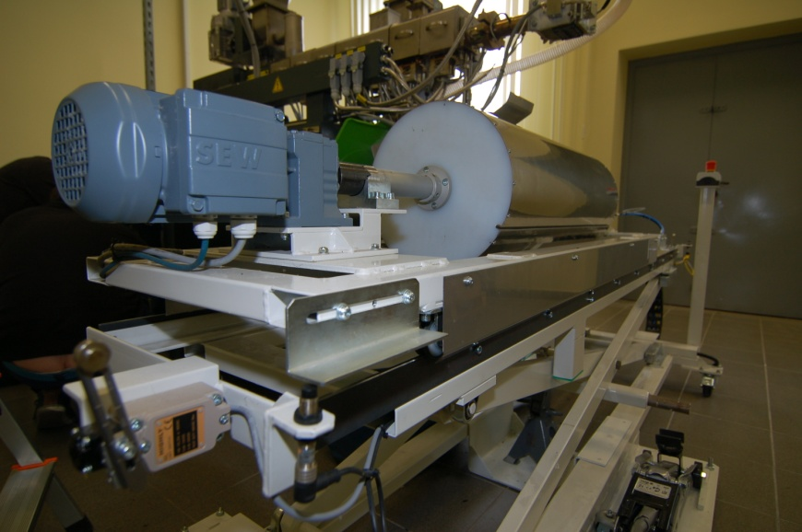
Product and production process being developed
Product being developed:
CNT-doped thermoplastic veils for improving electrical, thermal and mechanical performance of composites and reducing their weight.
Suitable for Antistatic or EMI Shielding applications.
CNT-doped veils are inserted into GFRP or CFRP during manufacturing of composites using infusion or pressing methods, as well as an autoclave.
Partners sought:
Producers of Composites for such industries as:
Aerospace, Automotive, Construction, Electronics, Defense
willing to develop an improved product with
enhanced electrical, thermal and mechanical properties.
5wt.% CNT-doped veil, GSM=20g/m² Melting range: 110-130°C
Notes:
How do we contribute to the creation of business?
1) We try to focus our research activities on topics that can lead to commercial applications. Often it is a very long road.
An example: In 2007 we performed a research project on Electro-conductive polymer matrix composites with improved mechanical properties where we did low TRL research. Then, we did two other projects on this topic funded by the European Union. Now, 9 years later, we are performing a fourth project on this topic, but we are at the stage of a pilot plant. We transferred the project results to a spin-off company, who built the pilot plant and is in charge of commercialising projects results. The product is a CNT-doped veil that is inserted in the composite during its production process and which changes the properties of the composite.
So, by the way, if anyone here is interested in producing composites that are electroconductive, thermoconductive, which exhibit improved mechanical properties, which can assure EMI shielding and are antistatic, I would be very happy to talk with him about cooperation possibilities.
2) We help businesses in finding R&D partners to solve their specific problems. Sometimes companies, specifically SMEs, come to us with a technological problem, and we redirect them to an appropriate institute or do the research ourself.
3) We help businesses in finding business partners. An example is our participation in the ELAN project. Polish companies are much more reluctant than, e.g. Spanish companies, to examine by themselves cooperation opportunities with Latin America. However, several of them asked us to represent them, do market research and find potential partners. We have first success – in June two Polish companies are going to Chile to negotiate with the partners we identified for them.
4) We help businesses in obtaining European or national money for performing research leading to developing products. We identify appropriate schemes and write applications.
5) We assist large companies in setting up large scale cooperation programmes with national authorities potentially leading to the development of new products and businesses. Currently, we are doing this in the Aeronautics sector.

Slide 7
Other TECHNOLOGY PARTNERS’ EU-funded projects
2008-16 MAAXIMUS - More Affordable Aircraft Through Extended, Integrated And Mature Numerical Sizing – FP7 large integrated project
2016-19 PHOBIC2ICE - Super-IcePhobic Surfaces to Prevent Ice Formation on Aircraft - H2020
2016-19 ACTTIVATE - PAn-European Clusters for Technology Transfer and new VAlue chains – H2020
2011-14 CANNAPE - Canadian Networking Aeronautics Project for Europe – FP7 C&SA
2015-18 ELAN - European and Latin American Business Services and Innovation Network - EUROPAID
2016-19 AERO.UA - Strategic and Targeted Support for Europe-Ukraine Collaboration in Aviation Research – H2020 Coordination and Support Action
Notes:
How do we contribute to the creation of business?
1) We try to focus our research activities on topics that can lead to commercial applications. Often it is a very long road.
An example: In 2007 we performed a research project on Electro-conductive polymer matrix composites with improved mechanical properties where we did low TRL research. Then, we did two other projects on this topic funded by the European Union. Now, 9 years later, we are performing a fourth project on this topic, but we are at the stage of a pilot plant. We transferred the project results to a spin-off company, who built the pilot plant and is in charge of commercialising projects results. The product is a CNT-doped veil that is inserted in the composite during its production process and which changes the properties of the composite.
So, by the way, if anyone here is interested in producing composites that are electroconductive, thermoconductive, which exhibit improved mechanical properties, which can assure EMI shielding and are antistatic, I would be very happy to talk with him about cooperation possibilities.
2) We help businesses in finding R&D partners to solve their specific problems. Sometimes companies, specifically SMEs, come to us with a technological problem, and we redirect them to an appropriate institute or do the research ourself.
3) We help businesses in finding business partners. An example is our participation in the ELAN project. Polish companies are much more reluctant than, e.g. Spanish companies, to examine by themselves cooperation opportunities with Latin America. However, several of them asked us to represent them, do market research and find potential partners. We have first success – in June two Polish companies are going to Chile to negotiate with the partners we identified for them.
4) We help businesses in obtaining European or national money for performing research leading to developing products. We identify appropriate schemes and write applications.
5) We assist large companies in setting up large scale cooperation programmes with national authorities potentially leading to the development of new products and businesses. Currently, we are doing this in the Aeronautics sector.

Slide 8
AERO.UA
European Partners:
Intelligentsia (Coordinator)
Fraunhofer
TECPAR
UoM
Strategic and Targeted Support for Europe-Ukraine Collaboration in Aviation Research (AERO.UA)
Expected Impacts:
Increased short-to-medium term EU-UA aviation research collaboration
Increased medium-to-long term EU-UA aviation research collaboration
Support to achieving Flightpath 2050 goals
Support to implementing EU-UA association agreement articles
High-Level Objectives / WPs:
Identifying the barriers to increased EU-UA aviation research collaboration (WP1)
Providing strategic support to EU-UA aviation research collaboration (WP2)
Supporting EU-UA aviation research knowledge transfer pilot projects (WP3)
Organising awareness-raising and networking between EU-UA stakeholders (WP4)
Ukrainian Partners:
Ivchenko
FED
UkrRIAT
NASU
KhAI
Notes:
How do we contribute to the creation of business?
1) We try to focus our research activities on topics that can lead to commercial applications. Often it is a very long road.
An example: In 2007 we performed a research project on Electro-conductive polymer matrix composites with improved mechanical properties where we did low TRL research. Then, we did two other projects on this topic funded by the European Union. Now, 9 years later, we are performing a fourth project on this topic, but we are at the stage of a pilot plant. We transferred the project results to a spin-off company, who built the pilot plant and is in charge of commercialising projects results. The product is a CNT-doped veil that is inserted in the composite during its production process and which changes the properties of the composite.
So, by the way, if anyone here is interested in producing composites that are electroconductive, thermoconductive, which exhibit improved mechanical properties, which can assure EMI shielding and are antistatic, I would be very happy to talk with him about cooperation possibilities.
2) We help businesses in finding R&D partners to solve their specific problems. Sometimes companies, specifically SMEs, come to us with a technological problem, and we redirect them to an appropriate institute or do the research ourself.
3) We help businesses in finding business partners. An example is our participation in the ELAN project. Polish companies are much more reluctant than, e.g. Spanish companies, to examine by themselves cooperation opportunities with Latin America. However, several of them asked us to represent them, do market research and find potential partners. We have first success – in June two Polish companies are going to Chile to negotiate with the partners we identified for them.
4) We help businesses in obtaining European or national money for performing research leading to developing products. We identify appropriate schemes and write applications.
5) We assist large companies in setting up large scale cooperation programmes with national authorities potentially leading to the development of new products and businesses. Currently, we are doing this in the Aeronautics sector.

